Slide 1
CLIP Feature utilization In Downstream V-L Tasks
Gao Jingchun 2022.11.18

Slide 2
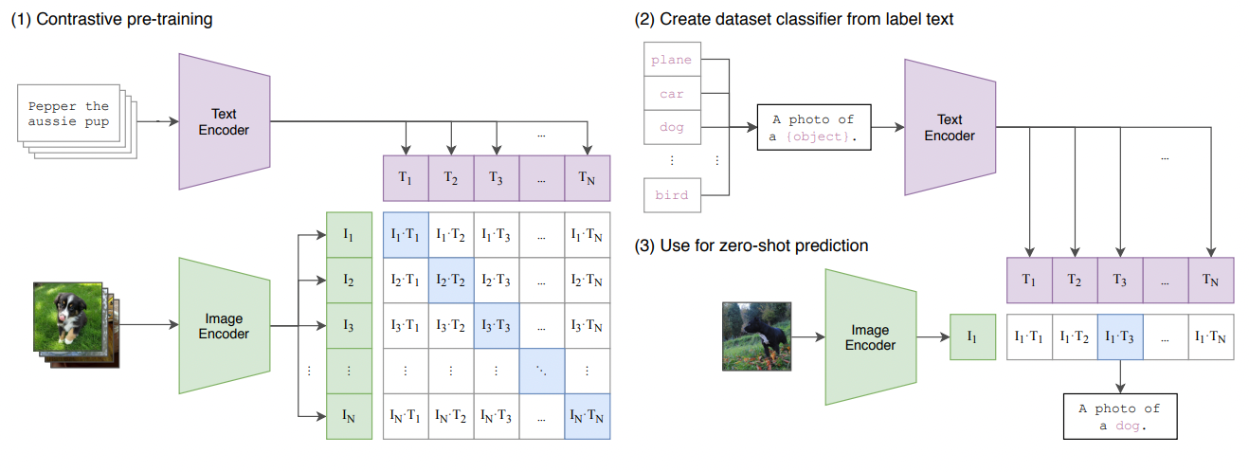
How Much Can CLIP Benefit Vision-and-Language Tasks?
CLIP Review
Version：
ResNet，
ViT,
customized models
Zero-shot learning for image classification——prompt learning
No human-annotated data
Strong generalization ability

Slide 3
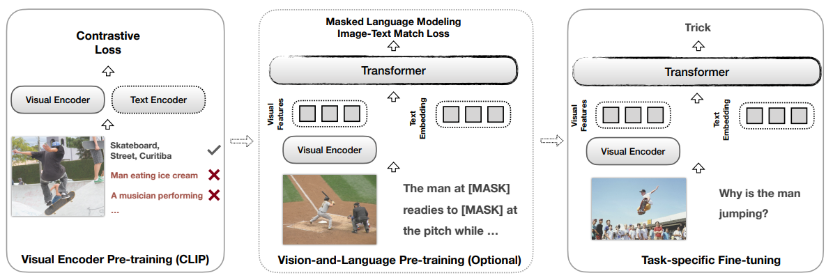
How Much Can CLIP Benefit Vision-and-Language Tasks?
Paradigm
cast other tasks into a zero-shot image-text retrieval task
plug CLIP into task-specific fine-tuning

Slide 4
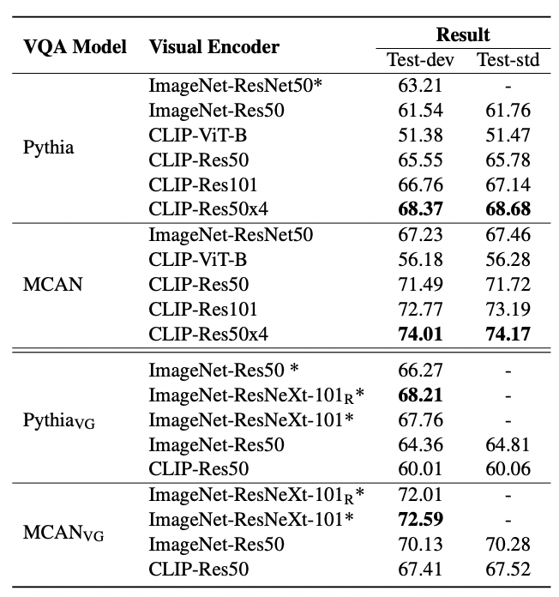
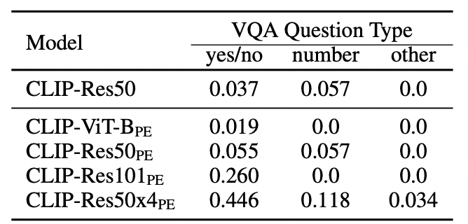
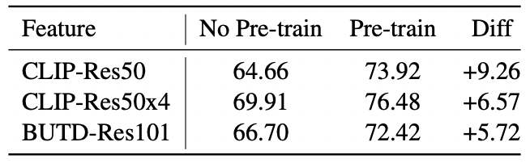
How Much Can CLIP Benefit Vision-and-Language Tasks?
Results in VQA without V&L Pretrain
Results in VQA under zero-shot setting
prompt template: “question: [question text]
answer: [answer text]”
Results in VQA with V&L Pretrain

Slide 5
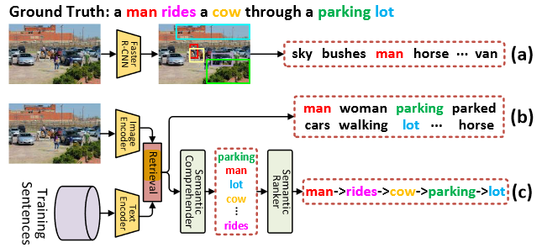
CLIP in image caption task
COS-Net
Motivation: To mitigate the “object hallucination”, get explicit semantic words as the inherent skeleton
CLIP acts as a cross-modal retrieval model and a visual encoder to provide grid feature and candidate words

Slide 6
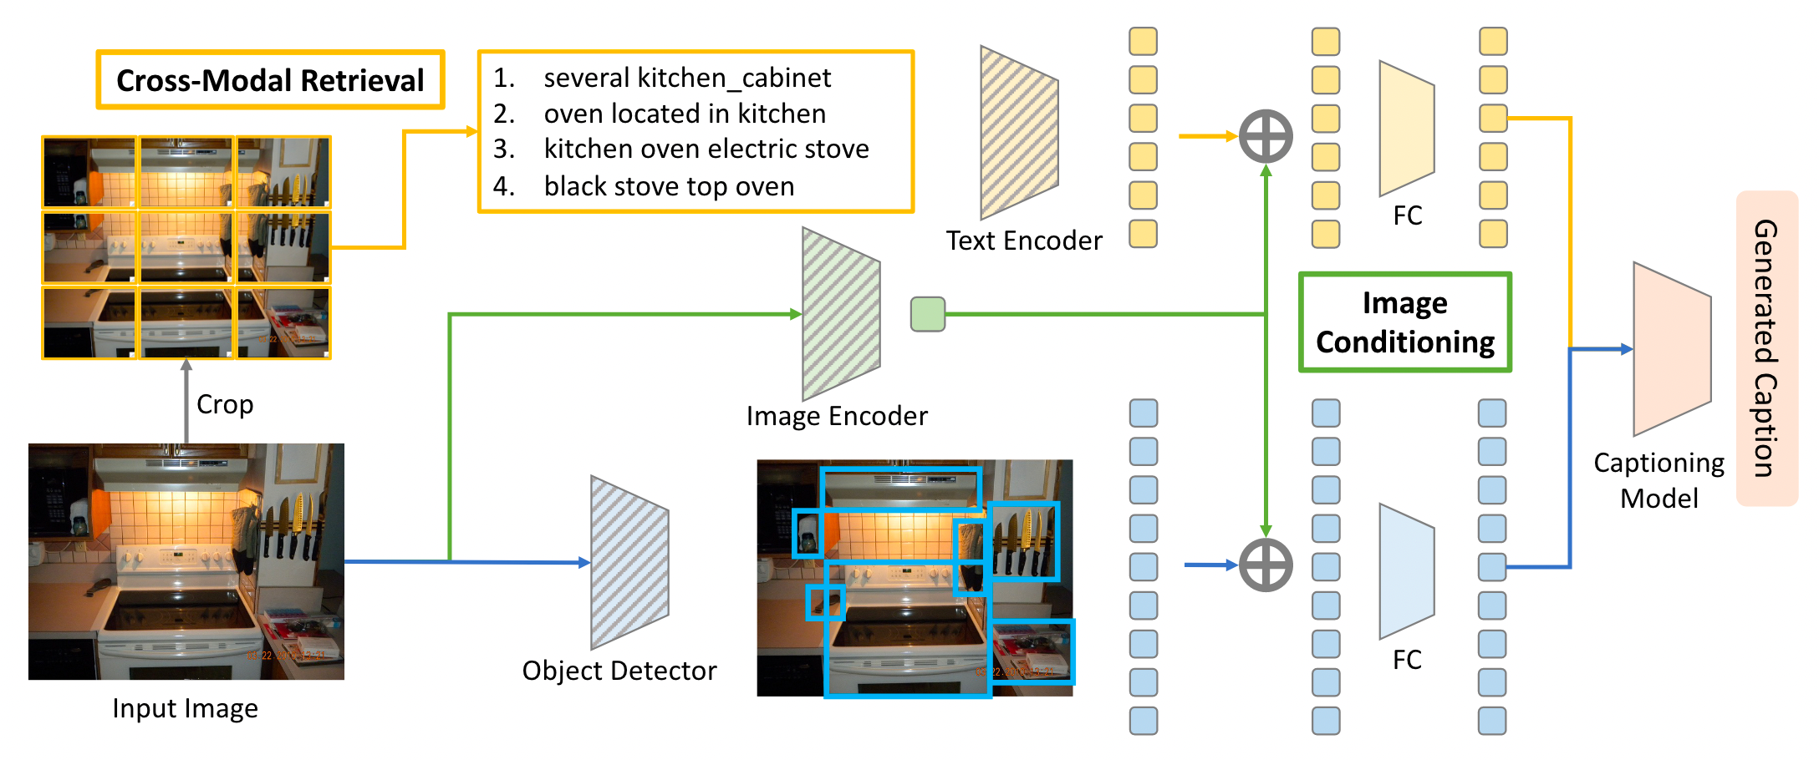
CLIP in image caption task
Beyond a Pre-Trained Object Detector
Model structure:

Slide 7
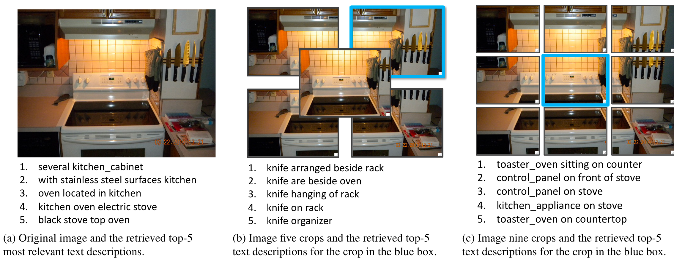
CLIP in image caption task
Beyond a Pre-Trained Object Detector
Motivation: A frozen pre-trained object detector fail to encode object predicates and image/scene level information
CLIP only acts as a cross-modal retrieval model, take into account both global and local information

Slide 8
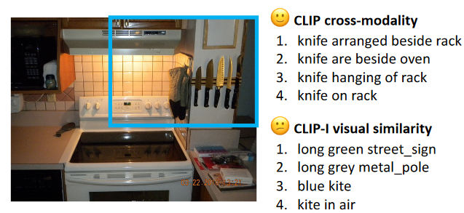
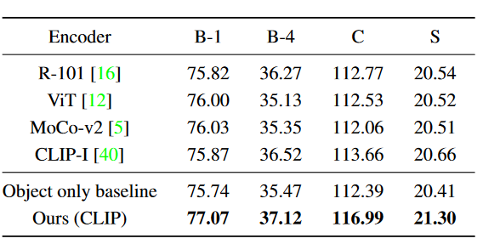
CLIP in image caption task
Beyond a Pre-Trained Object Detector
In the other hand, the visual similarity is unreliable

Slide 9
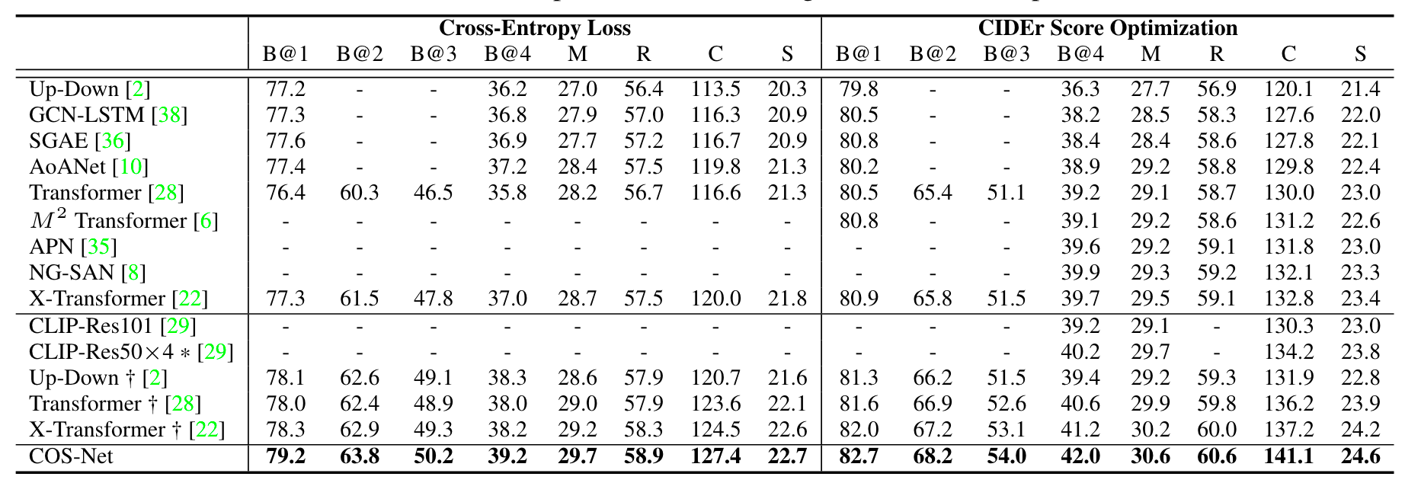
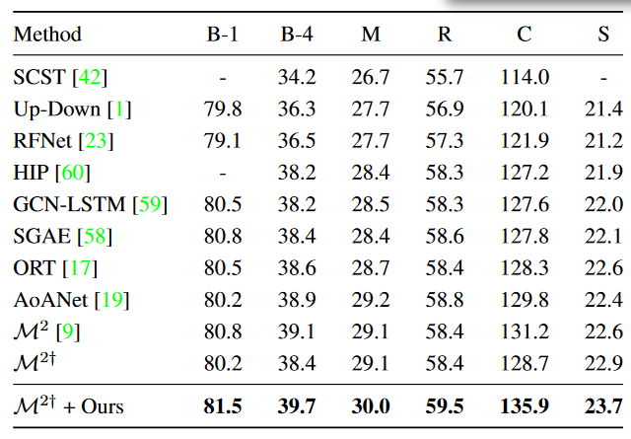
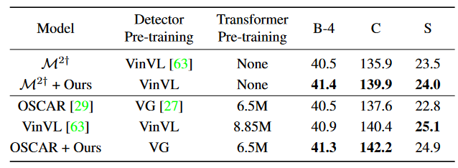
CLIP in image caption task
Quantitative results
Beyond a Pre-Trained Object Detector

Slide 10
CLIP in image caption task
Summary
CLIP is often regarded as a retrieval model, providing some open-vocabulary semantic words without the limitation of close-set class labels. At the same time, the semantic words retrieved are noisy labels.
The extraction and fusion of local and global information is still a open-question when plugging CLIP.
Few prompt engineering in recent research in COCO dataset is used to generate object, attribute and relation labels.

Slide 11
Improvement
Semantic segmentation
Open-Vocabulary Semantic Segmentation with Mask-adapted CLIP(ICLR2023)
GroupViT: Semantic Segmentation Emerges from Text Supervision(CVPR2022)
Extract Free Dense Labels from CLIP(ECCV2022)
Visual relation detection
Visual Distant Supervision for Scene Graph Generation(ICCV 2021)
Winoground: Probing Vision and Language Models for Visio-Linguistic
Compositionality(CVPR 2022)

Slide 12
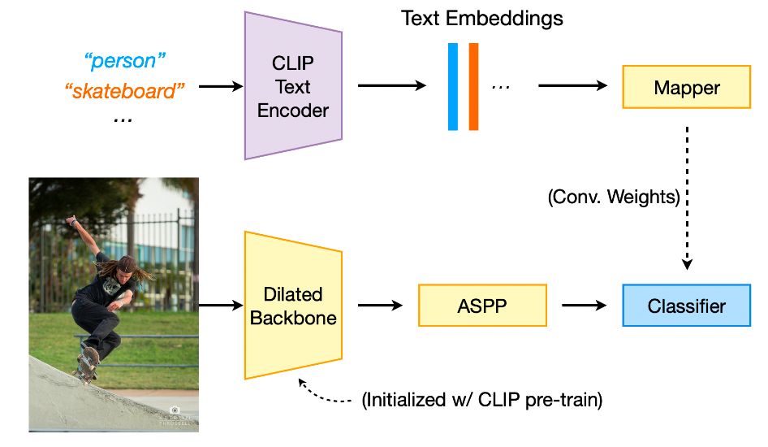
Per-Pixel Method
DenseCLIP: Extract Free Dense Labels from CLIP
A direct approach
Small dataset finetuned
Difference of network architecture
Only train on data of seen classes
Weak generalization ability

Slide 13
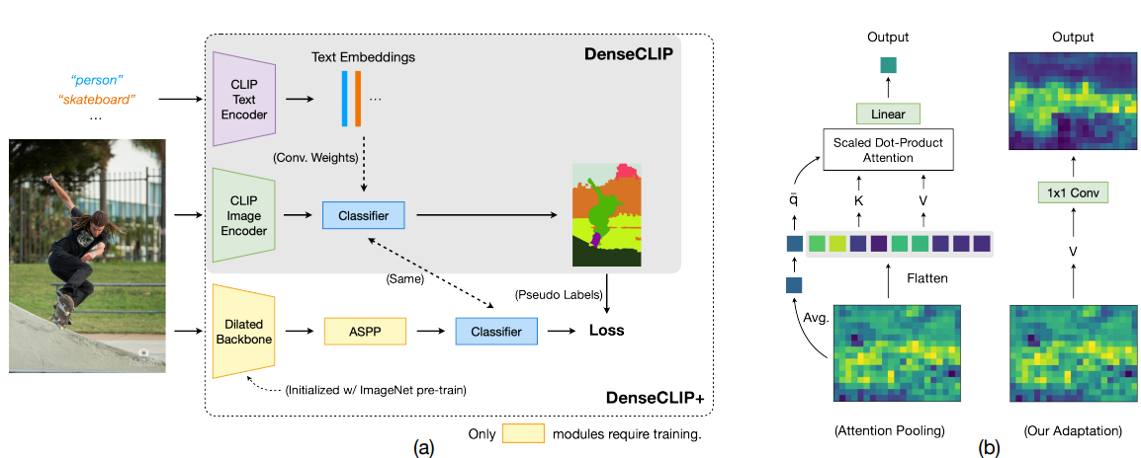
Per-Pixel Method
DenseCLIP: Extract Free Dense Labels from CLIP
Method
Without training, modify the structure of CLIP-RN50
Attention pooling → 1x1 convolutional layers
Retain the visual-language association of CLIP

Slide 14
Per-Pixel Method
DenseCLIP: Extract Free Dense Labels from CLIP
To benefit from more advanced architectures about segmentation task
DenseCLIP-Guided Learning
Self-Training
The CLIP visual encoder only is used in the train-time
Notes:
得到的初始的分割结果有很多的噪点，性能指标很差，所以文章又设计了后续的训练，为了能从现阶段专门为分割任务设计的先进结构中获得性能增长，使用上面提到的denseclip生成的分割结果作为伪标签，来指导一个分割专用网络的训练，只需要使用imagenet预训练得到的参数初始化它的visual backbone，分类器使用与denseclip一样的1x1卷积，这样得到了叫做denseclip+的模型。
其实使用的就是知识蒸馏的方法，将clip中丰富的图文关联知识蒸馏到这个分割专用模型中，一段时间的训练后denseclip+的效果会与denseclip持平，从这个时候开始使用自训练的策略，新模型自己给自己生成标签进行训练，进一步提升性能。
注意这里的clip图像编码器只在训练中被使用，推理阶段只有学习到的分割专用网络

Slide 15
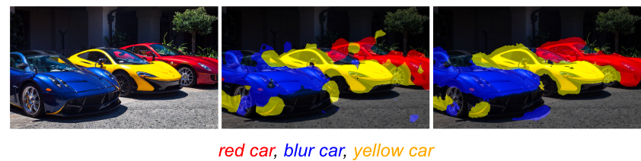
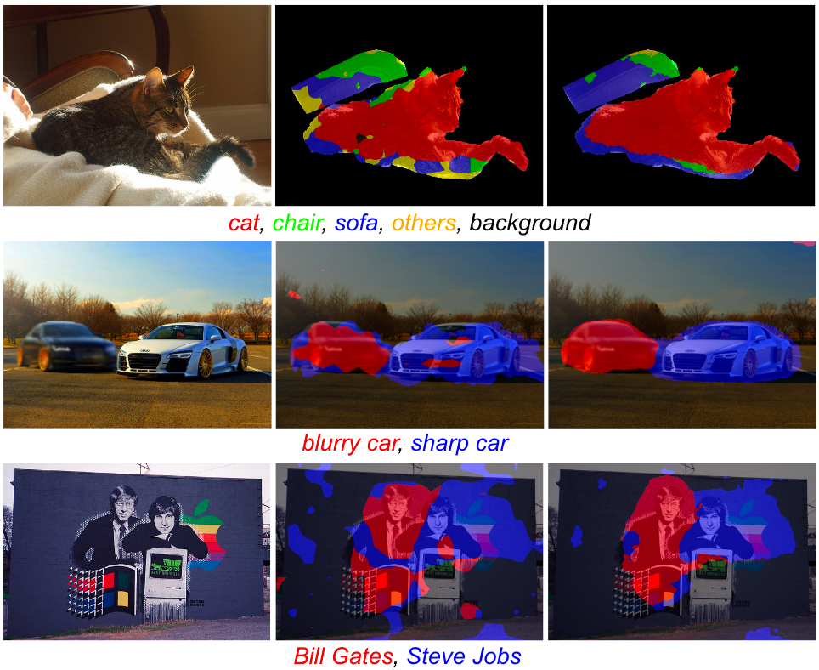
Per-Pixel Method
DenseCLIP: Extract Free Dense Labels from CLIP
Results
Original image denseclip denseclip+
Fine-grained concepts
Novel concepts:
Celebrities…
Imagery properties

Slide 16
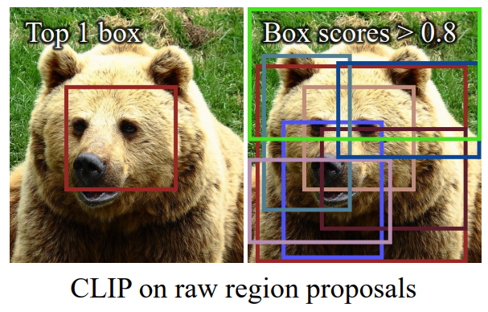
Two-stage OV-Segmentation method
In image classification task, there is only one object in one image. The ability of CLIP to understand complex scene is not verified.
Some research find out the weak localization ability when applying CLIP.
Two-stage methods:
Generate class-agnostic mask proposals
leverage pre-trained vision-language models to predict the category
[1] Shiyu Zhao, Zhixing Zhang, et al. Exploiting Unlabeled Data with Vision and Language Models for Object Detection ECCV 2022

Slide 17
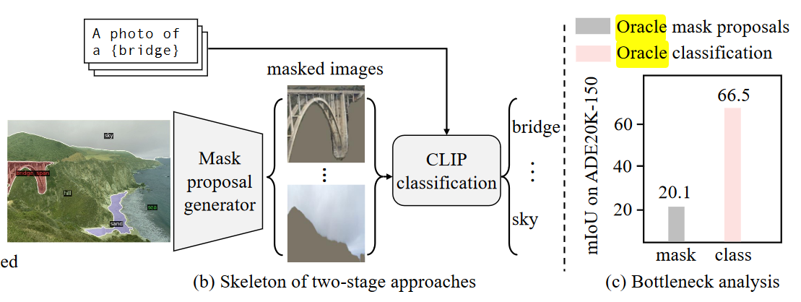
Open-Vocabulary Semantic Segmentation with Mask-Adapted CLIP
Two-stage OV-Segmentation method
Motivation
From a oracle Experiment
The bottleneck is obviously that CLIP can’t predict the label of masked image precisely
Notes:
这篇工作投在了今年ICLR上，使用的是双阶段方法进行分割。首先文章做了一个性能瓶颈的实验，探究性能瓶颈到底在哪个阶段，是mask proposal生成的不好，还是clip预测的精度不行。
如图所示，如果将clip分类部分去掉，直接给每个proposal赋ground-truth label，最后的mIoU可以达到66.5，而如果去掉前面的proposal生成器，直接将真实的mask结果给clip进行分类，最终的mIoU只有20.1，相差巨大，可以得出结论，问题出在clip不能对带有mask的图像做出准确的预测

Slide 18
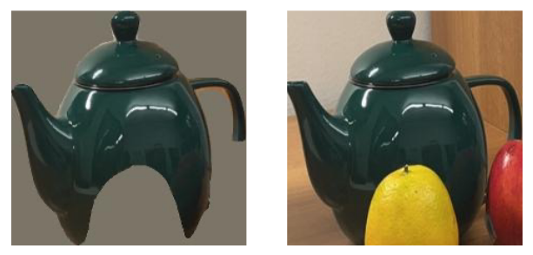
Open-Vocabulary Semantic Segmentation with Mask-Adapted CLIP
Two-stage OV-Segmentation method
Analysis
Reason: Domain gap between masked image and natural image——many “blank areas”
Trying: Also try the direct crop without mask but perform worse than masked image
20.1% --> 13.8%
Weak localization ability, effected by other object
Notes:
一个带有mask的图像和自然图像的最大区别就是mask图像的背景是空白的，这和clip的训练图像存在严重的domain gap，自然图像不会有这种情况出现，所以文章也尝试将proposal周围的像素保留，然后把这一小块图像裁剪下来进行预测，但是这样操作分类效果要更差，其实也不难理解，这样图片中也有别的物体，刚刚介绍的那个熊的例子，不需要完整的物体也可以迷惑clip，就像这个橘子，大概率会影响水壶的分类

Slide 19
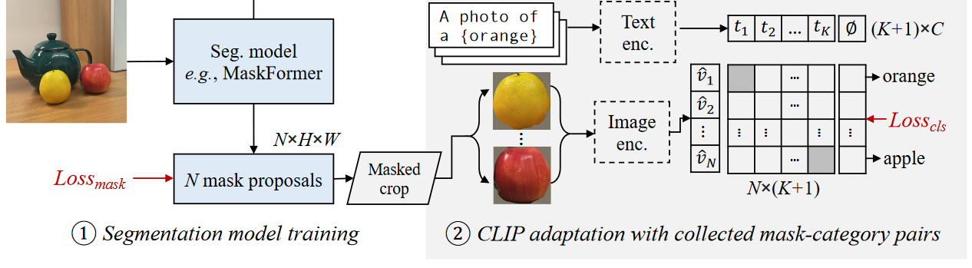
Open-Vocabulary Semantic Segmentation with Mask-Adapted CLIP
Two-stage OV-Segmentation method
Solution
Finetuning and prompt engineering
The part of model structure. MaskFormer acts as a mask proposal generator and CLIP predict a class label for the masked image.

Slide 20
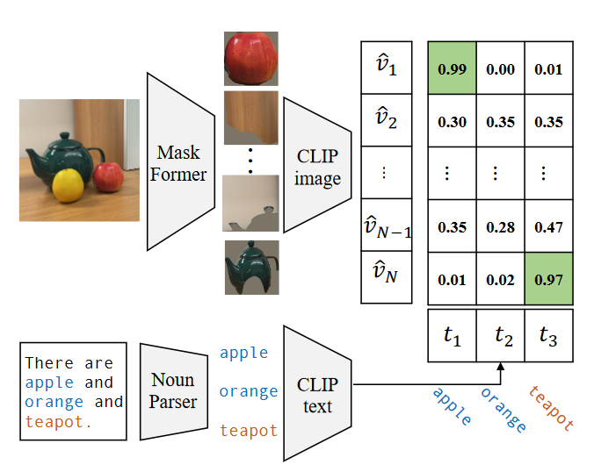
Open-Vocabulary Semantic Segmentation with Mask-Adapted CLIP
Two-stage OV-Segmentation method
Finetuning
(1) Using original ground truth mask
labels in COCO-Stuff dataset
× 171 class number, finite, weak
generalization ability
(2) Using the caption annotation in
COCO Caption dataset, parsing the
nouns of the captions, and aligning
them to the proposals with CLIP
√ 440K pairs with 12K nouns

Slide 21
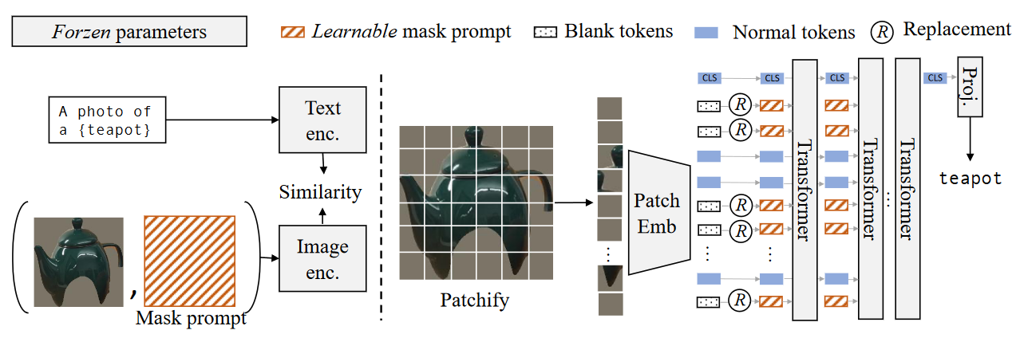
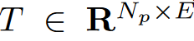
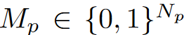
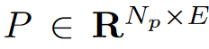
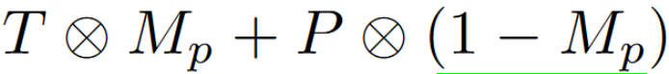
Open-Vocabulary Semantic Segmentation with Mask-Adapted CLIP
Two-stage OV-Segmentation method
Mask prompt tuning
Deeper prompt
a masked image
token
Indicator matrix
a learnable prompt
tokens
The final token

Slide 22
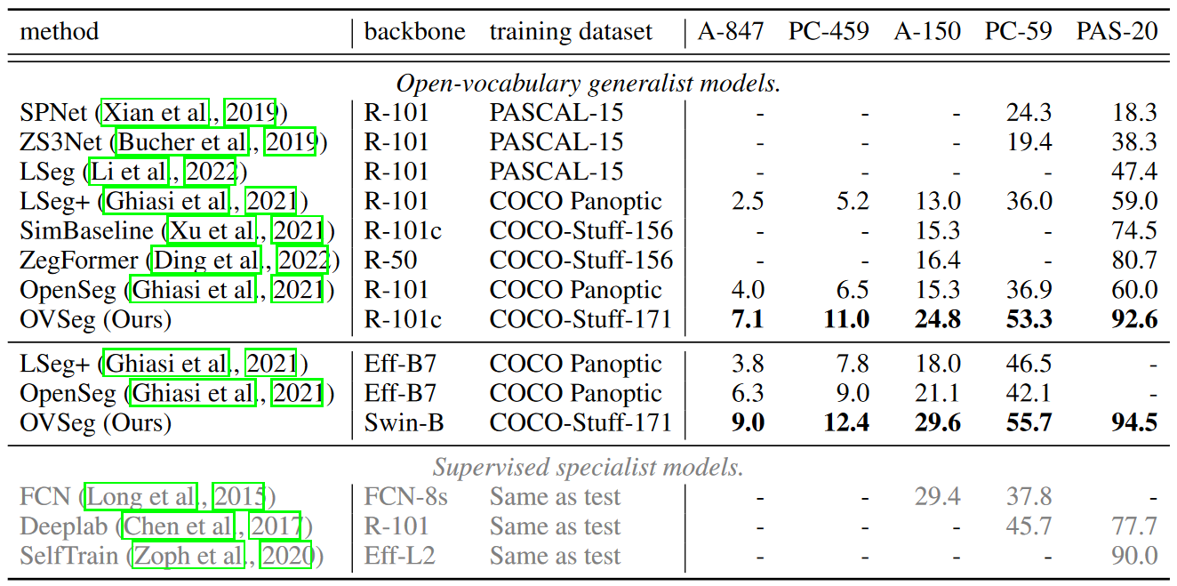
Open-Vocabulary Semantic Segmentation with Mask-Adapted CLIP
Two-stage OV-Segmentation method
Results
Notes:
最后仅需要在coco-stuff数据集上进行训练，就可以实现直接在其他数据集上做测试，而且指标已经逼近了针对具体数据集训练的监督学习方法

Slide 23
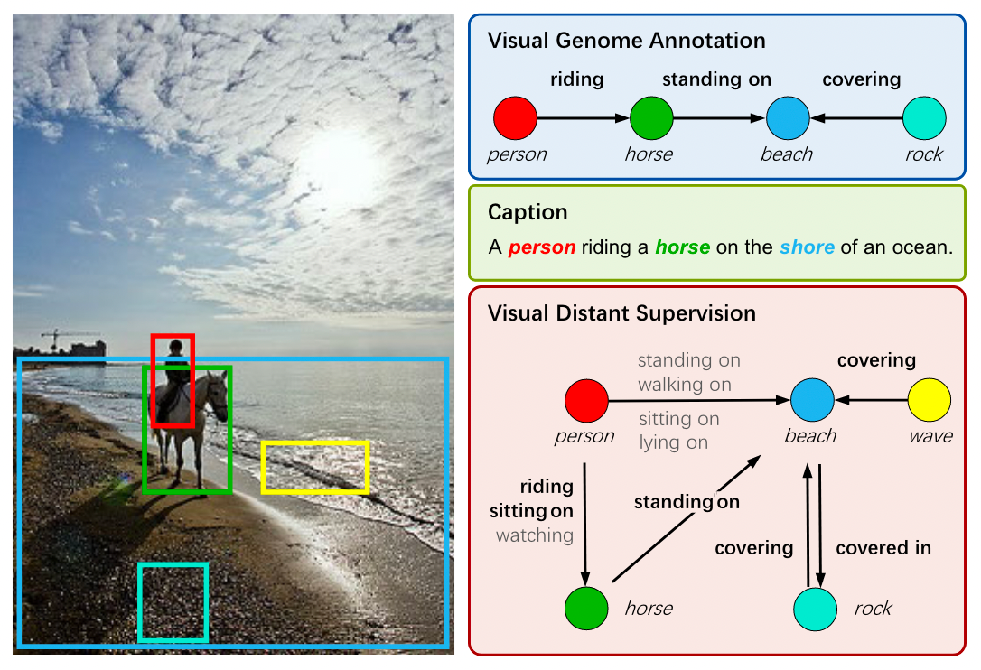
Visual Relation Prediction
Visual Distant Supervision for Scene Graph Generation
Human-labeled data suffer from the long-tail relation distribution
semi-supervised learning
human annotation that scales linearly with the number of relations
weakly supervised learning
Benefit from caption, only a few salient relations

Slide 24
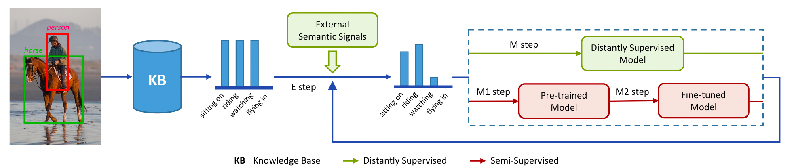
Visual Relation Prediction
Visual Distant Supervision for Scene Graph Generation
Method
Knowledge knowledge base construction and Image Alignment.
extract relational triples from Conceptual Captions (person, riding, horse)
Get the images and object annotations from input image
Visual Genome or object detectors
3. Filter: assign distant relation labels for
an object pair only if the bounding boxes
have overlapping areas.

Slide 25
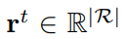
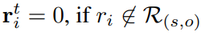
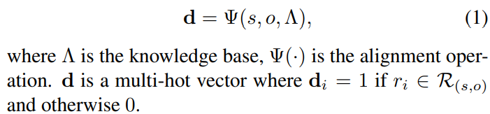
Visual Relation Prediction
Visual Distant Supervision for Scene Graph Generation
Method
probabilistic distribution over all relations
Denoising for Visual Distant Supervision
EM Algorithm
ground-truth relation labels --> latent variables
E Step
The initial iteration(t=1), if no external signals
From M step model result
r¹ = d

Slide 26
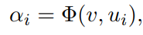
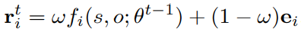
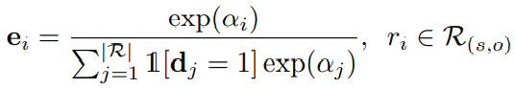
Visual Relation Prediction
Visual Distant Supervision for Scene Graph Generation
Method
Denoising for Visual Distant Supervision
E Step
The initial iteration(t=1), if external signals yes
adopt CLIP
non-initial iteration(t>1)
Update
the similarity score
Normalize to relation distribution
r¹ = e
From M step model result

Slide 27
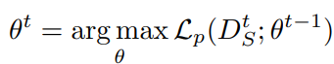
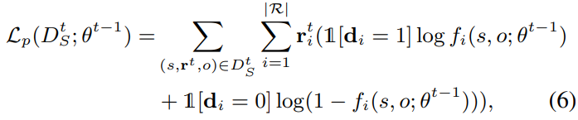
Visual Relation Prediction
Visual Distant Supervision for Scene Graph Generation
Method
Denoising for Visual Distant Supervision
M Step
optimize the scene graph model parameters θ_{t−1}
entropy-based log-likelihood function
From M step model result
Notes:
在极大步就和正常训练模型是一致的了，使用期望步得到的soft label作为ground truth，然后进行预测模型参数的更新，得到新一代的参数，使用的损失就是BCE损失，增加ground-truth中标签出现的概率

Slide 28
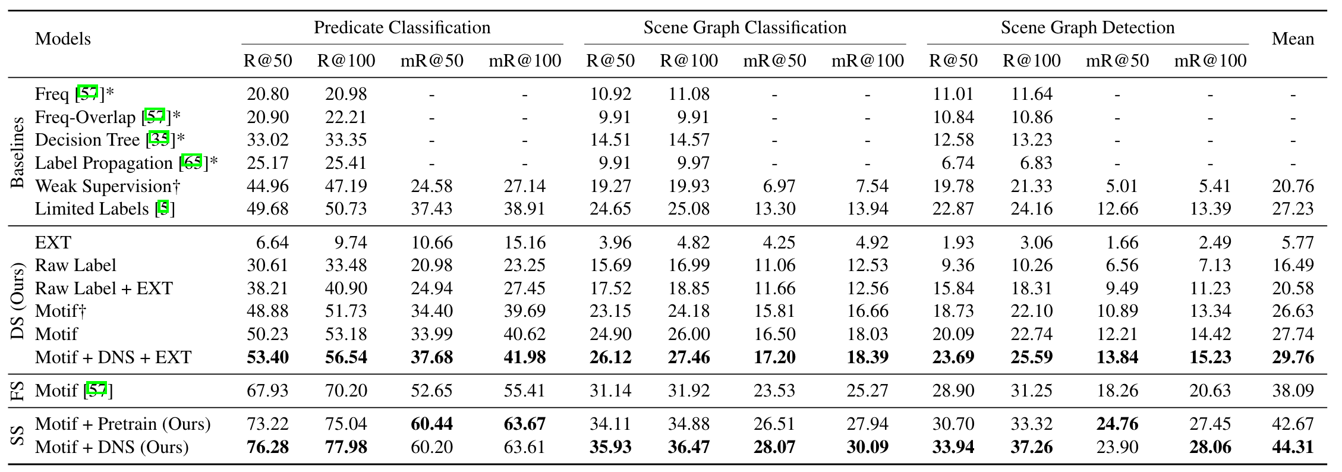
Visual Relation Prediction
Visual Distant Supervision for Scene Graph Generation
Results

Slide 29
Thanks！

